Slide 1
SQUEEZE!
By: Alejandro B, Diego B, Nick F, Jose B (Group 2)

Slide 2
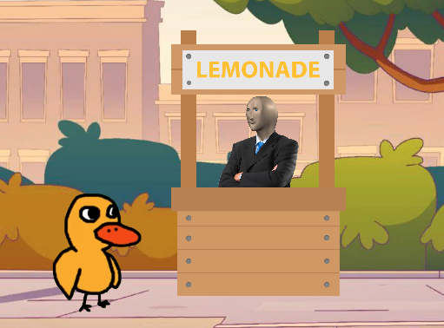
What is Squeeze?
Squeeze is an educational game designed to teach financial literacy
The player has control in managing their product; including product pricing, cost management, and inventory management.
The player is challenged by pricing risk and customer satisfaction which can lower overall performance and customers that show up to your business.
You sell lemonade and various other products based on customer demand.

Slide 3
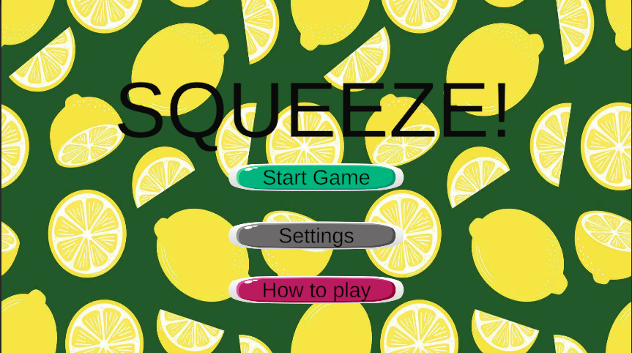
LIVE DEMO!

